Slide 1
IOT AGRITECH
ANVESHANA
Theme - SMART Future: Technology's Role in Sustaining the
Five Elements

Slide 2
Problem Statement
In the realm of sustainable agriculture, the inefficient use of water resources remains a critical challenge. Conventional irrigation methods often lead to water wastage, over-irrigation, and inadequate monitoring of soil conditions. As a result, there is a pressing need for an innovative solution that seamlessly integrates technology to enable precision irrigation, optimize water usage, and contribute to the broader goal of sustainable agricultural practices.

Slide 3
Introduction
Enables users to remotely monitor and control irrigation settings for enhanced convenience.
Empowers users to nurture plants efficiently while contributing to global water scarcity solutions.
Continuous soil moisture assessment triggers precise irrigation, conserving water resources and enhancing agricultural productivity.
Smart Irrigation System blends technology seamlessly with eco-conscious water management.
Utilizes advanced components—soil moisture sensors, bidirectional water pumps, and ESP32 controller—for accurate and efficient irrigation.
Adaptable to rural and urban settings, optimizing crop irrigation and fostering sustainable gardening.

Slide 4
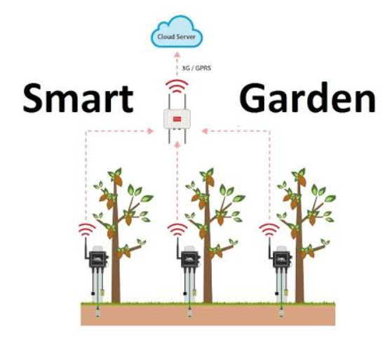
Design and Implementation

Slide 5
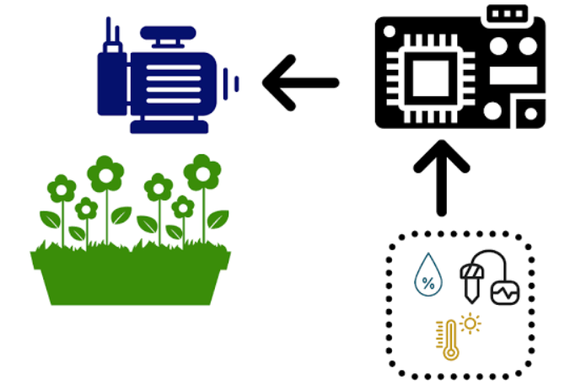
Design and Implementation

Slide 6
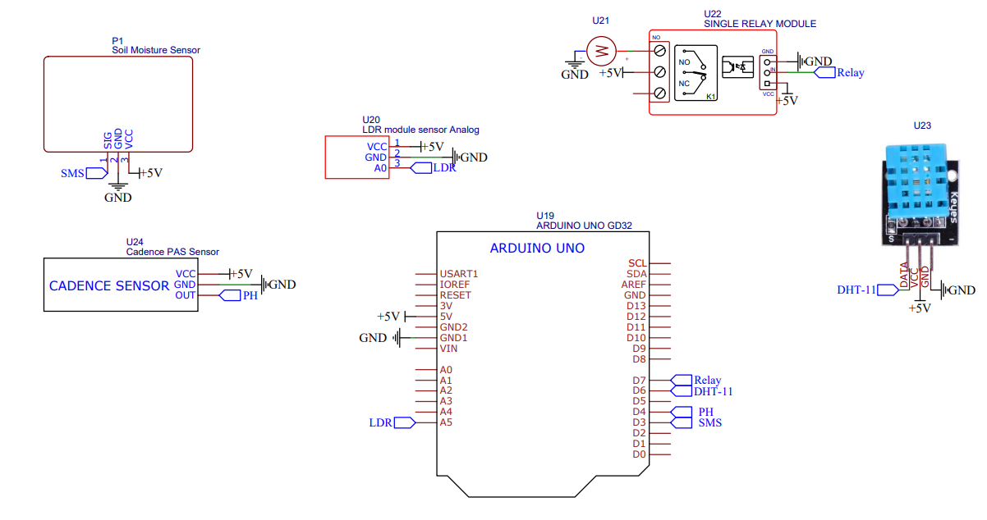
Schematic Design

Slide 7
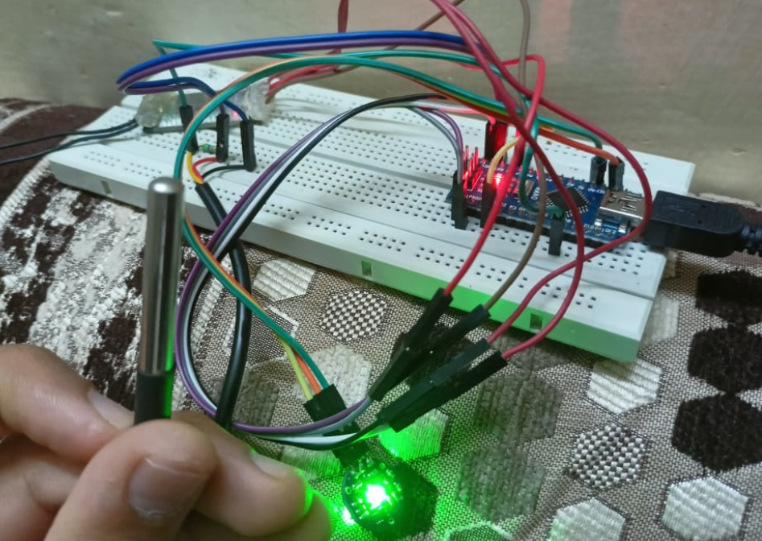

Slide 8
Features
PORTABLE
I.
II.
EASY INSTALLATION
EASY MAINTENANCE
III.
IV.
AVAILABLE ON BOTH APP AND WEB
EASY TO USE
V.
VI.
SCALABLE

Slide 9
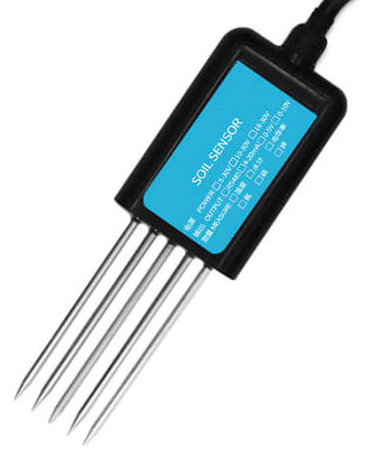
Future Scope
We plan to enhance our Smart Irrigation System by integrating a soil nutrient sensor. This addition will enable comprehensive monitoring of soil health, ensuring plants receive essential nutrients for optimal growth.

Slide 10
Thank
You!
Team Members: Aabhaas Sikka, Adarsh Goyal, Ishika Punchariya
Students: Meenu, Charu
Mentor: Dr Kavita Sheoran, Associate Professor, MSIT
College: Maharaja Surajmal Institute of Technology, Delhi

